Slide 1
DEPARTMENT OF ELECTRICAL AND ELECTRONICS ENGINEERING
18EEP202L-MINOR PROJECT – II
SECOND REVIEW
SUPER MARKETING IN ADVANCED TECHNOLOGY
YEAR/ SEMESTER – II /IV
BATCH NUMBER : 15
DATE : 17/05/2024
GUIDED BY J. UMA
PROFESSOR & HEAD
PRESENTED BY:
S. RAM PRAKASH(927622BEE086)
S.SAPREENA(927622BEE099)
B.SRINIDHI(927622BEE114)

Slide 2
LIST OF CONTENTS
Problem Statement
Objective
Abstract
Description
Block Diagram
Cost Estimation

Slide 3
PROBLEM STATEMENT
The customer and sellers are facing so many problems during billing section.
The customer does not know the total amount of the all products during purchasing.
At last during billing section the customer rejecting the some products as side in table.
So the seller need to appoint new workers for rearranging the products .

Slide 4
OBJECTIVE
The minimalization cost is important.
By using this idea the customer know the exact amount of all the products.
So the seller does not have extra work

Slide 5
Efficiency: Enhance the shopping process by automating tasks such as item scanning and checkout, reducing wait times, and improving overall shopping efficiency.
Customer Experience: Provide shoppers with a seamless and enjoyable experience by offering personalized recommendations, store navigation, and real-time promotions.

Slide 6
Customer Experience: Provide shoppers with a seamless and enjoyable experience by offering personalized recommendations, store navigation, and real-time promotions.
Inventory Management: Assist retailers in managing their inventory effectively by monitoring stock levels, reducing theft, and optimizing restocking procedures.

Slide 7
PROJECT DESCRIPTION :
The smart shopping cart project aims to revolutionize the traditional shopping experience by introducing cutting edge technology and convenience for both shoppers and retailers . This innovative project combines hardware and software solutions to create an intelligent shopping cart that streamlines the entire shopping journey . Below is an overview of the projects key features and components..

Slide 8
BLOCK DIAGRAM
OUTPUT
LCD DISPLAY
TROLLEY
QR CODE READER
INPUT
ARDUINO BOARD

Slide 9
ABSTRACT
Super marketing in advanced technology addresses a total amount of the product to buyer in “LED DISPLAY”. By placing QR Scanner in trolley the amount of the product will be shown in display.

Slide 10
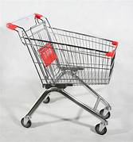
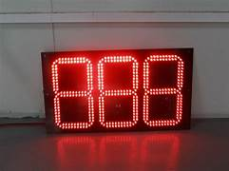
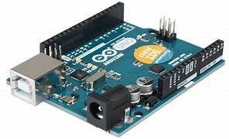
BLOCK DIAGRAM

Slide 11
COST ESTIMATION
S.NO | COMPONENT DESCRIPTION | QUANTITY | COST
1 | TROLLEY | 1 | 2000
2 | QR code scanner | 1 | 1500
3 | LED Display Board | 1 | 300
4 | Arduino components | 1 | 255
 |  | TOTAL | 4055

